Slide 1
NEWYORK AIRBNB BOOKING
NAME : INDRA RAJA S
BATCH : JUNE-DADS

Slide 2
CONTENTS
INTRODUCTION
DATA UNDERSTANDING
DATA CLEANING
HANDLING MISSING VALUES
OUTLIER HANDLING
STATISTICAL ANALYSIS
DATA VISUALIZATION / EDA
CONCLUSION AND RECOMMENDATION

Slide 3
INTRODUCTION
Brief Introduction:
The aim of this project is to store, organize, and analyze information from the REINFO.csv dataset to derive meaningful insights through data processing, statistical analysis, and visualization.
Problem Statement/Objective:
The main objectives are to manage the data, clean and preprocess it for accurate analysis, perform exploratory data analysis (EDA), identify patterns and relationships between variables, and provide insights to support decision-making.

Slide 4
DATA UNDERSTANDING
Dataset Used:
The dataset is named REINFO.csv.
Key Attributes/Variables:
The dataset contains 9999 rows and 16 columns. Key attributes include id, name, host id, host name, neigh bour hood group, neigh bour hood, latitude, longitude, room type, price, minimum nights, number of reviews, last review, reviews per month, calculated host listings count, and availability_365.

Slide 5
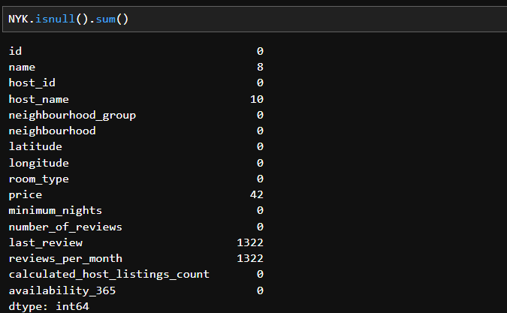
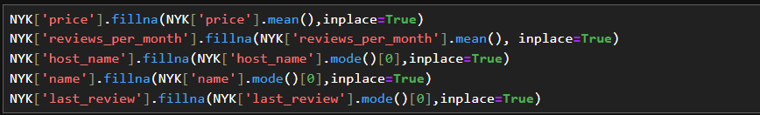
DATA CLEANING
Null values has been detected while data cleaning and by using fillna() function the null values values has been removed

Slide 6
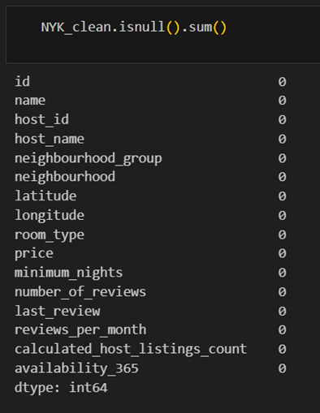
High-level Steps:
The data was cleaned using various Python functions, including isnull(), dropna(), drop duplicates(), and fillna(). The info(), describe(), unique(), shape, head(), and tail() functions were also used to understand the data before and after cleaning.
Explanation:
Data cleaning is essential to prepare raw data for analysis by correcting or removing inaccurate , incomplete or irrelevant part.

Slide 7
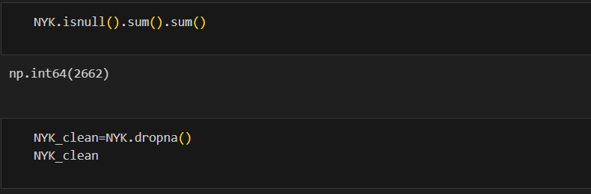
HANDLING MISSING VALUES
Approach:
The approach taken was to identify and remove all rows with missing values.
Methods Used:
The isnull().sum().sum() function was used to find the total number of missing values (2662). Then, the dropna() function was applied to the entire dataset to remove rows with any missing data. This resulted in a clean dataset with 8666 rows and 16 columns and zero missing values.

Slide 8
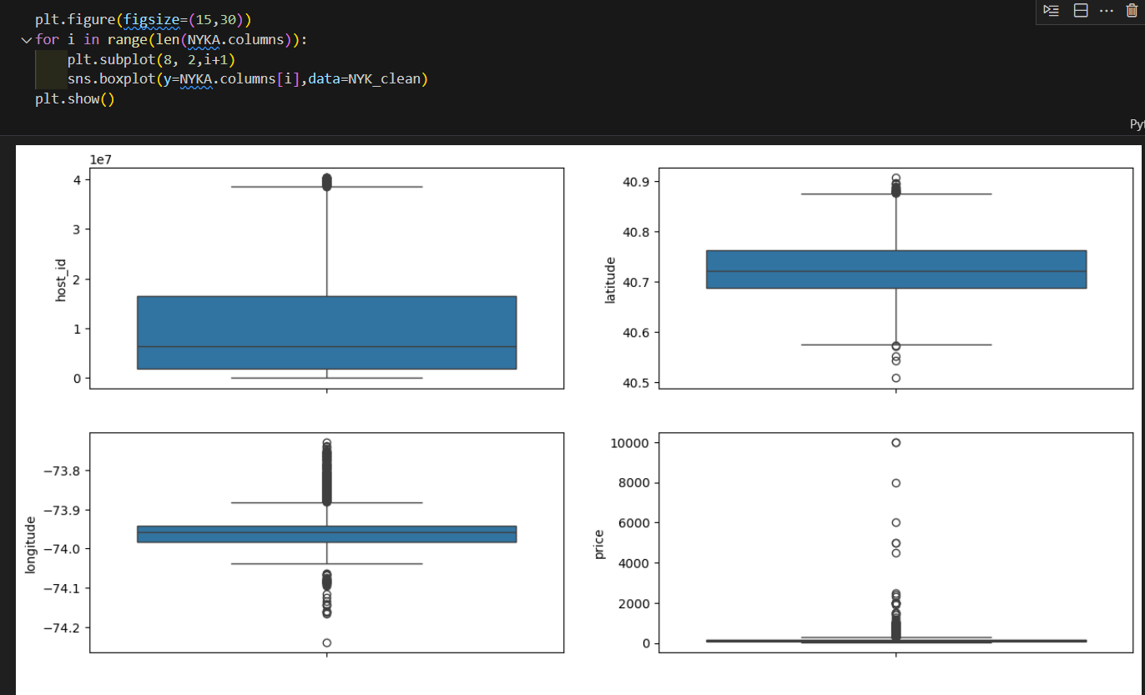
OUTLIER HANDLING

Slide 9
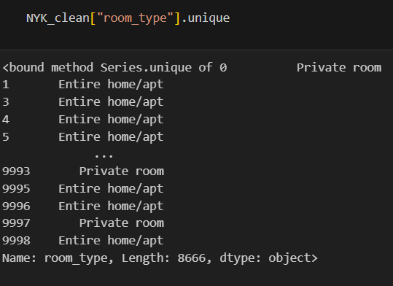
HANDLING INVALID VALUES
Discussion:
The analysis explicitly mention or show a separate process for handling invalid or incorrect data points.

Slide 10
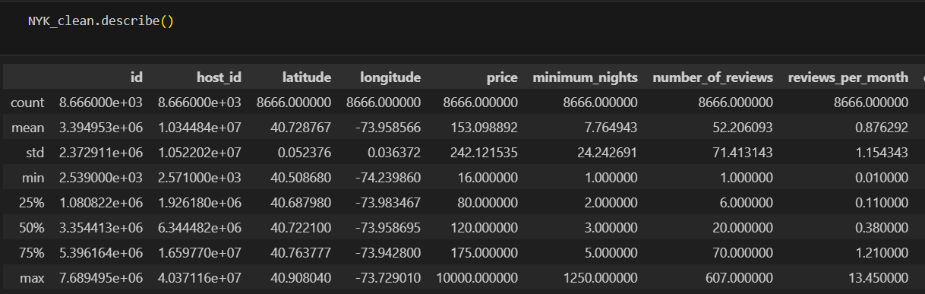
DESCRIPTIVE STATISTICS
Overview:
The descriptive analysis provided a statistical summary for numerical columns, including
count, mean, standard deviation, minimum, and maximum values, using the describe() function.

Slide 11
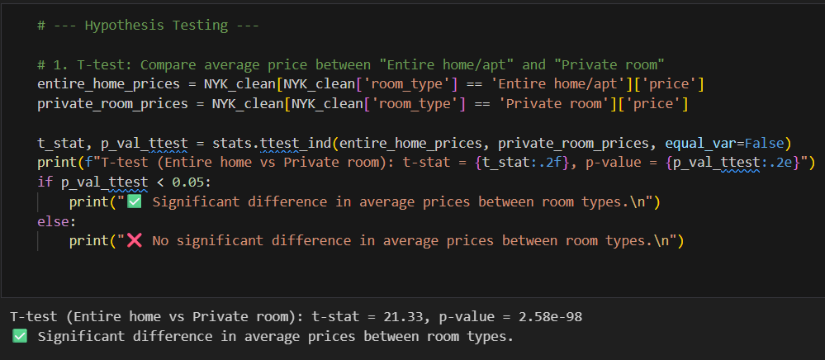
HYPOTHESIS TESTING
T-Testing:
INSIGHTS:-
Statistical Significance:
The p-value is far below any conventional threshold (e.g., 0.05), so we can confidently reject the null hypothesis.
There is an difference in average prices between Entire home/apt and Private room listings.
Direction of Difference:
Since the t-stat is positive and you're comparing Entire home vs Private room.
Entire homes/apartments are significantly more expensive than private rooms.

Slide 12
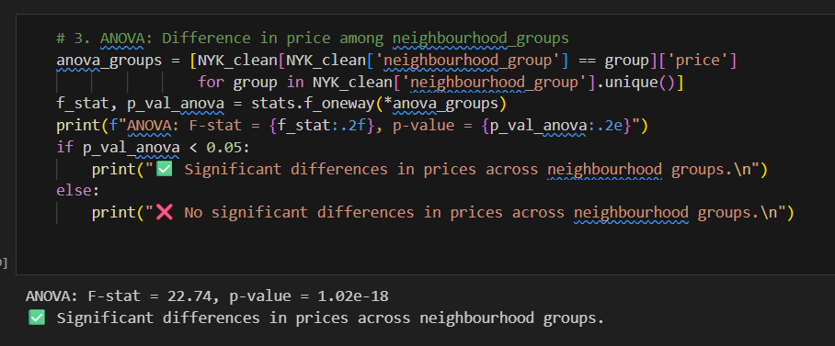
ANOVA TESTING
INSIGHTS
F-statistic = 22.74
This tells us that the variation in prices between neighbourhoods is much larger than the variation within each neighbourhood.
p-value = 1.02e-18
That’s an extremely small number—way below the usual threshold of 0.05. It means the result is statistically significant.

Slide 13
DATA VALIDATION
Introduction:
Data visualization is used to summarize and understand the dataset. The project used Python libraries Matplotlib and Seaborn for statistical data visualization.
Types of Visualizations Used:
The analysis used charts to visualize the distributions and relationships and shows data frames which could be converted into various chart types.

Slide 14
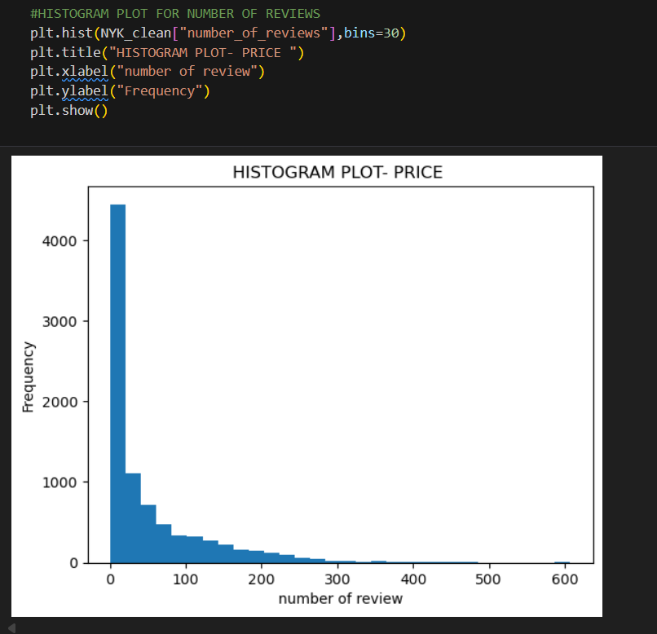
UNIVARIATE ANALYSIS
Insights from the Histogram:-
Most listings have very few reviews (close to 0–20).
A small number of listings have very high reviews (100–600).*
The peak is at the very beginning (0–10 reviews), with the frequency above 4000 listings.
This means the majority of hosts have only a handful of reviews.
The frequency gradually decreases as the number of reviews increases.
A few listings stand out with extremely high review counts, which may be popular or older listings.
Listings with more than ~300 reviews can be considered outliers, since they are rare compared to the bulk of the data.

Slide 15
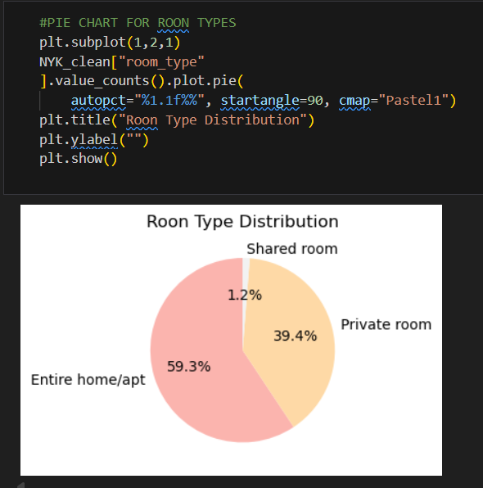
PIE CHART
Insights from pie chart:-
Makes up 59.3% of listings.
This suggests that most hosts are offering full properties rather than just rooms.
Likely appeals to families, groups, or long-term stays. About 39.4% of listings.
Indicates a strong presence of budget-friendly or solo traveler–oriented options.
Only 1.2% of listings.
Suggests that guests prefer privacy, and hosts rarely offer dorm-style/shared spaces.

Slide 16
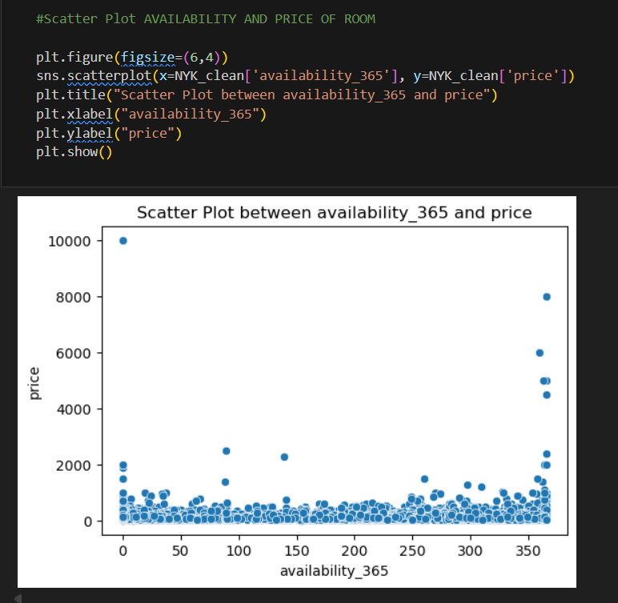
BIVARIATE ANALYSIS
Insights for scatter plot:-
Prices are scattered across all availability levels (0–365 days).
This suggests that price does not directly depend on availability.
Many listings have availability = 0 (probably inactive or blocked calendars).
Another big cluster is around availability = 365 (hosts making their listing available all year).
Most prices are concentrated below 1000 regardless of availability.
A few outliers exist with prices up to 10,000, but these are rare and may be unrealistic or luxury listing

Slide 17
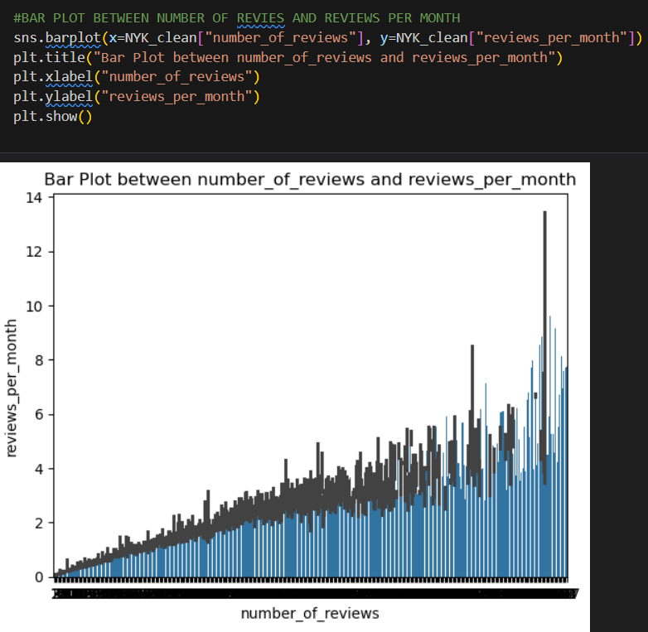
BAR PLOT
Insights for bar plot:-
As the number of reviews increases, the reviews per month also tends to increase.
This makes sense: listings with many total reviews are often more active and keep receiving frequent reviews.
For listings with a very high number of reviews, the reviews per month vary widely (from near 0 to above 12).
Some listings show >10 reviews per month, which is unusually high.
These could be extremely popular listings, or in rare cases, data entry errors.
The bars generally form an increasing upward slope, confirming that listings with more accumulated reviews also sustain higher monthly review rates.

Slide 18
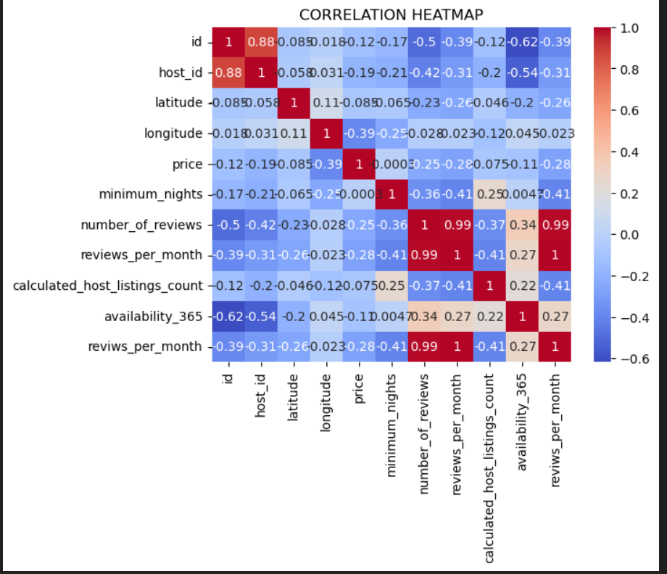
MULTIVARIATE ANALYSIS
Insights for heatmap:-
Strong Relationships-
Reviews per Month & Number of Reviews:Correlation ≈ 0.99These two are nearly identical in behavior—unsurprising, since reviews per month is likely derived from total reviews over time.
Minimum Nights & Revivs per Month: Correlation ≈ 0.41Could imply that listings with longer minimum stays tend to have more consistent monthly reviews.
Negative Correlations-
Price & Reviews per Month: Correlation ≈ -0.41Higher-priced listings tend to receive fewer monthly reviews, hinting at lower booking frequency or niche appeal.
Host ID & Availability (365): Correlation ≈ -0.54Hosts with more listings might have less availability per listing, possibly due to calendar management or seasonal operations.

Slide 19
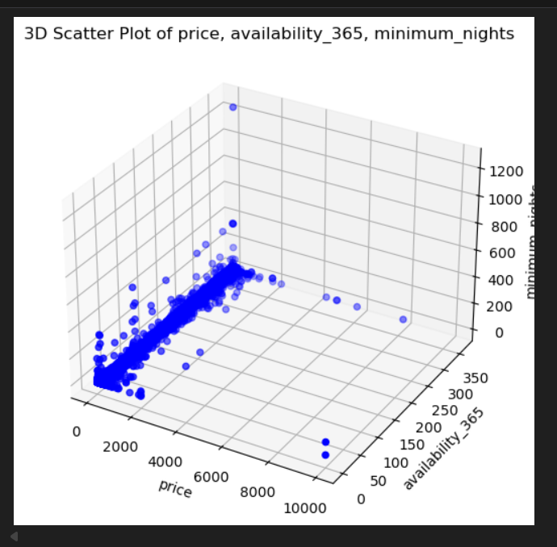
3D SCATTER PLOT
Insights for 3D scatter plot :-
price distribution:
Most listing are clustered at lower price(below~2000)
Minimum nights:
A few extreme cases have unususally high minimum nights(above 1000) which might inidicate data error or very restrictive hosts.
Availability_365:
Many properties seems available for either very few days or alomost the entire years.

Slide 20
CONCLUION & RECOMMENDATION
Key Findings and Insights:
The exploratory data analysis (EDA) revealed several key insights about the dataset, which appears to be focused on Airbnb listings.
Data Cleaning:
The initial dataset contained missing values, which were successfully handled by dropping the corresponding rows, resulting in a cleaned dataset of 8666 rows.
Price and Minimum Nights:
While there is no strong linear correlation between price, minimum nights, and availability, the data shows that most dense clusters of listings have low prices and low minimum nights.
Availability_365:
Many properties are either available for very few days or for almost the entire year.
High-priced Listings:
High-priced listings do not necessarily correspond to high availability or a high number of minimum nights.
Data Anomalies:
A few extreme cases with unusually high minimum nights (over 1000) were identified, which may be data errors.

Slide 21
Recommendations:
Based on these findings, here are some recommendations for further analysis and potential business strategies
Investigate Price Anomalies:
The presence of listings with unusually high prices (above $2000) should be further investigated. It would be beneficial to determine if these are data entry errors or if they represent a specific niche of high-end properties.
Analyze High-availability Properties:
Since many properties are available for almost the entire year, a deeper dive into these listings could be useful. This could involve looking at factors like location, host reputation, and room type to understand what makes them continuously available.
Segment the Market:
The analysis shows that different market segments behave differently. It is recommended to segment the market based on factors like room_type, neighbourhood, and price to tailor recommendations and strategies for different groups of hosts and guests.

Slide 22


